Slide 1
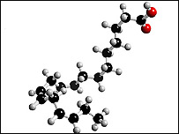
OMEGA-3 FATTY ACIDS
bbc.co.uk
By: Brandi Barnhill,RN,BSN
Melissa Cummins,RN,BSN
Amanda Janisse,RN,BSN
Janice Williams,RN,BSN

Slide 2
What are Omega-3’s
babyboomercaretaker.com
Polyunsaturated fatty acids (PUFA)
2 types of polyunsaturated fats based on the position of the first double bond site
omega-3 fatty acids
Omega-6 fatty acids
Omega-6 fatty acids-vegetable oils, safflower oils, corn oil, peanuts, soybeans
Omega-3 fatty acids- fish, flaxseed, walnuts, soybean, and vegetable oils
DeFilippis,A, and Sperling, L. (2006). Understanding omega-3’s. American Heart Journal. 151:565-70.

Slide 3
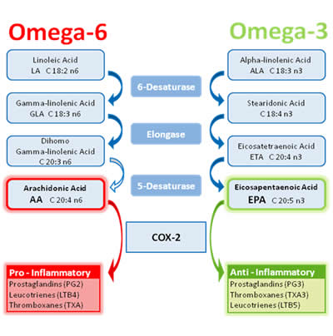
Rationale for Use Cardiovascular
Use in primary and secondary prevention
Conversion of ALA to EPA
Dietary shift toward less Omega-3’s may have significant negative impact on one’s health
omega-6 generally proinflammatory and proaggretory
omega-3 associated with anti-inflammatory and inhibit platelet aggregation
WWW.PROJECTSWOLE.COM
DeFilippis,A, and Sperling, L. (2006). Understanding omega-3’s. American Heart Journal. 151:565-70.

Slide 4
Rationale for Use Cardiovascular
healthsdelight.com
Vascular inflammation
Beneficially influence factors related to CVD risk including
Ventricular arrhythmias
Thrombosis
Apolipoprotein B
High-density lipoprotein
Adhesion molecule expression in plaque
Platelet-derived growth factor
Nitric oxide-induced endothelial relaxation
Blood pressure
DeFilippis,A, and Sperling, L. (2006). Understanding omega-3’s. American Heart Journal. 151:565-70.

Slide 5
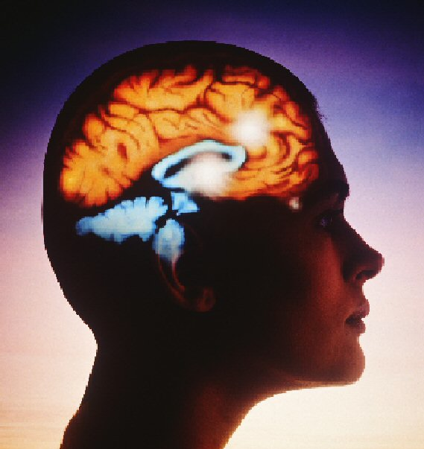
Rationale for Use Women’s Mental Health
Depression found to have inflammatory etiology
EPA efficacy in treating depression
EPA and DHA safe in pregnant and postpartum women in moderate doses
Perinatal depression-inflammatory etiology
Stress triggers inflammatory response which increases risk of depression
Kendall-Tackett, K. Long-Chain omega-3 fatty acids and women’s mental health in
the perinatal period and beyond. Journal of midwifery & women’s health. 55.6.
topnews.in

Slide 6
Rationale for Use Women’s Mental Health
interleukin-1β, interleukin-6, and tumor necrosis factor- α
EPA lowers inflammation by competing for same metabolic pathways as proinflammatory arachidonic acid
High levels of omega-3’s related to lower levels of the proinflammatory cytokines
EPA/DHA down regulate stress response
High levels of EPA/DHA associated with lower inflammatory response to stress
Kendall-Tackett, K. Long-Chain omega-3 fatty acids and women’s mental health in
the perinatal period and beyond. Journal of midwifery & women’s health. 55.6.
betterhealthresearch.com

Slide 7
Rationale for Use Women’s Mental Health
Populations consuming more fatty cold water fish had higher levels of EPA and DHA and lower rates of affective disorders
Iceland, Finland, and Japan-low incidence of seasonal depression likely associated with fish consumption
Depression 10 times more common in countries where people do not eat fish or eat small amounts of it
DHA important during pregnancy
EPA/DHA supplements considered safe for pregnant/lactating women
Kendall-Tackett, K. Long-Chain omega-3 fatty acids and women’s mental health in
the perinatal period and beyond. Journal of midwifery & women’s health. 55.6.
medindia.net

Slide 8
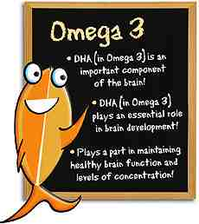
Rationale for Use Neurological and Psychiatric
Omega-3 fatty acids play role in
Nervous system activity
Cognitive development
Memory-related learning
Neuroplasticity of nerve membranes
Synaptogenesis
Synaptic transmission
mynextbrain.com
Possible mechanisms by which EPA/DHA could improve mood in bipolar disorder
Possible EPA/DHA relationship in suicide occurrence
mynextbrain.com
Mazza, M. Pomponi, M., Janiri, L., Bria, P., & Mazza, S. (2007). Omega-3 fatty acids and antioxidants in neurological and psychiatric disease: An overview. Progress in Neuro-Pharmacology & Biological Psychiatry. 31: 12-26

Slide 9
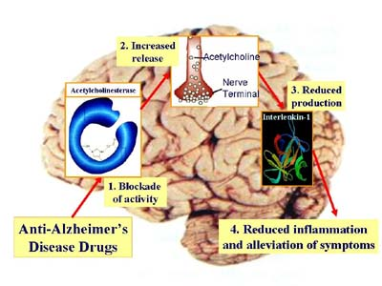
Rationale for Use Neurological and Psychiatric
MRI technology-EPA treatment associated with structural brain changes
omega-3 together with vitamins and dietary advice may improve clinical outcome in patients with newly diagnosed MS
DHA decreased in Alzheimer's disease and other neurodegenerative disorders
Cognitive impairment and/or dementia
medicineworld.org
Mazza, M. Pomponi, M., Janiri, L., Bria, P., & Mazza, S. (2007). Omega-3 fatty acids and antioxidants in neurological and psychiatric disease: An overview. . Progress in Neuro-Pharmacology & Biological Psychiatry. 31: 12-26

Slide 10
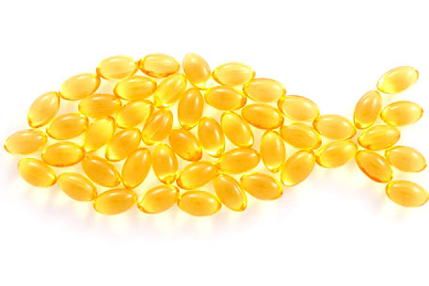
Research Supporting Omega-3 Fatty Acid Intake
“Over the past two decades, researchers have discovered that inflammation has a causal role in the pathogenesis of depression and a wide range of physical diseases, including cardiovascular disease, metabolic syndrome, diabetes, and cancer.” (Kendall-Tackett, p.561)
lower incidence rates of affective disorders, post-partum depression, and bipolar disorder are directly related to high intake of fatty fish (Kendall-Tackett, 2010)
thehealthyteacher.com

Slide 11
Research Supporting Omega-3 Fatty Acid Intake
Populations that have diets with high fish consumption have lower incidence of suicidal ideation (Mazza et al, 2006).
Reduce the risk of developing Alzheimer’s disease (Mazza et al, 2006)
Act as anti-inflammatories that aid in the treatment of autoimmune diseases (Mazza et al, 2006).
“Omega-3 supplementation is associated with an improvement of attentional and physiological functions, particularly those involving complex cortical processing” (Mazza et al, p.13).
thehealthyteacher.com

Slide 12
Research Supporting Omega-3 Fatty Acid Intake
Prevention of secondary cardiac events
Reduces mortality from ischemic heart disease
Reduction of serum triglycerides
Increase in low-density lipoproteins
thehealthyteacher.com

Slide 13
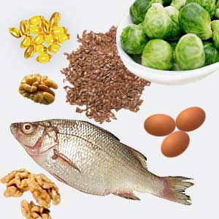
Methods of Consuming Omega-3 Fatty Acids
EPA/DHA Sources
Salmon Mackerel Halibut Sardiens Anchovies Tuna Oyster Lobster
ALA Sources
Flaxseeds, Flaxseed oil, Canola (rapeseed) oil, Soybeans, Soybean oil, Pumpkin seeds, Pumpkin seed oil, Purslane, Perilla seed oil, Walnuts, Walnut oil
Omega 3 fatty acid supplements/ Fish oil
targetwoman.com

Slide 14
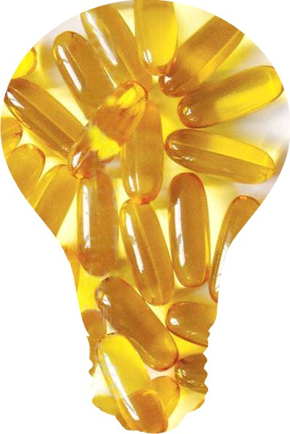
Patient Selection Criteria for Omega-3 Therapy
Patients with or at risk for CV disease (Gebauer, Psota, Harris, & Kris-Etherton, 2006), including patients with diabetes mellitus (Hartweg, Montori, Dinneen, & Neil)
Patients with deficiency or potential deficiency (Gebauer, Psota, Harris, & Kris-Etherton, 2006)
Prenatal, pre-term and term infants (Mazza, Pomponi, Janiri, Bria, & Mazza, 2007)
Cancer patients with cachexia (Dewey, Baughan, Dean, Higgins, & Johnson)
Patients with severe triglyceride levels: >500 mg/dL, and moderate levels: 200-499 mg/dL
supplementalscience.wordpress.com
supplementalscience.wordpress.com

Slide 15
Patient Selection Criteria for Omega-3 Therapy
Patients with bipolar disorder (Lehne, 2006)
Patients with depression, especially seasonal (Mazza, Pomponi, Janiri, Bria, & Mazza, 2007)
Pregnant and postpartum women (Kendall, 2010)
Multiple sclerosis patients (Mazza, Pomponi, Janiri, Bria, & Mazza, 2007)
Alzheimer’s disease & age-related cognitive impairment (Mazza, Pomponi, Janiri, Bria, & Mazza, 2007)
supplementalscience.wordpress.com

Slide 16
Contraindications
77 studies revealed no adverse events at all (DeFilippis & Sperling, 2006)
Fish oil is a more prudent choice in men than alpha-linoleic acid (plant-based) supplement until the potential association with prostate cancer risk is more thoroughly researched (DeFilippis & Sperling, 2006)
penn-olson.com

Slide 17
Desired Outcomes
Prevent deficiency- prevent impaired visual acuity and learning deficiencies
(Gebauer, Psota, Harris, & Kris-Etherton, 2006)
Cancer cachexia- weight loss, promote weight gain, increase survival time (Dewey, Baughan,
Dean, Higgins, & Johnson)
Cardio-protection- risk of fatal ischemic heart disease, sudden cardiac death, non-fatal myocardial infarction,
incidence of ischemic stroke
Primary hypertriglyceridemia- triglycerides and low-density lipoprotein(DeFilippis & Sperling, 2006)
Bipolar disorder-Stabilize mood & increase periods of remission (Lehne, 2006)
Depression- the symptoms of seasonal depression (Mazza, Pomponi, Janiri, Bria, &
Mazza, 2007)
Geriatric population- risk of Alzheimer’s disease and cognitive decline associated with age (Mazza,
Janiri, Bria, & Mazza, 2007)
Pregnant women- Mixed results in reducing postpartum depression (Kendall, 2010)
aromamassage789.wordpress.com

Slide 18
References
DeFilippis, A. P., & Sperling, L. S. (2006). Understanding omega-3's. American Heart Journal , 151, pp. 564-570.
Dewey, A., Baughan, C., Dean, T. P., Higgins, B., & Johnson, I. (n.d.). Eicosapentaenoic acid (an omega-3 fatty acid from fish oils) for the treatment of cancer cachexia. Cochrane Database of Systemic Reviews 2007, Issue 1, Art. No.: CD004597. doi: 10.1002/14651858.CD004597.pub2.
Gebauer, S. K., Psota, T. L., Harris, W. S., & Kris-Etherton, P. M. (2006). Omega-3 fatty acid dietary recommendations and food sources to achieve essentiality and cardiovascular benefits. American Journal of Clinical Nutrition , 83 (supplement), pp. 1526S-1535S.
Hartweg, J., Montori, V. M., Dinneen, S. F., & Neil, A. H. (n.d.). Omega-3 polyunsaturated fatty acids (PUFA) for type 2 diabetes mellitus. Cochrane Database of Systemic Reviews 2008, Issue 1. Art. No.: CD003205. doi: 10.1002/14651858.CD003205.pub2.
Kendall, K. (2010). Long-chain omega-3 fatty acids and women's mental health in the perinatal period and beyond. Journal of Midwifery and and Women's Health , 55, pp. 561-567.
Lehne, R. A. (2006). Pharmacology for Nursing Care (6th ed.). St. Louis, MO: Saunders.
Mazza, M., Pomponi, M., Janiri, L., Bria, P., & Mazza, S. (2007). Omega-3 fatty acids and antioxidants in neurological and psychiatric diseases: An overview. Progress in Neuro-Pharmacology & Biological Psychiatry , 31, pp. 12-26.

